Slide 1
Data Analysis
Pizza Sales Data Analysis Project

Slide 2
"Unlocking Data Insights: A Showcase of Solved SQL Query Projects"
Here diffrent 4 diffrent tables used for Analyze the Pizza Sales!
Tables | No of Rows | Columns
Pizzas | 97 | Pizza_id, Pizza_type, Size, Price
Pizza_type | 33 | Pizza_type, Name, Category, Ingredients
Orders | 21350 | Order_id, Date, Time
Order_details | 48620 | Oder_details_id, order_id, Pizza_id, Quantity

Slide 3
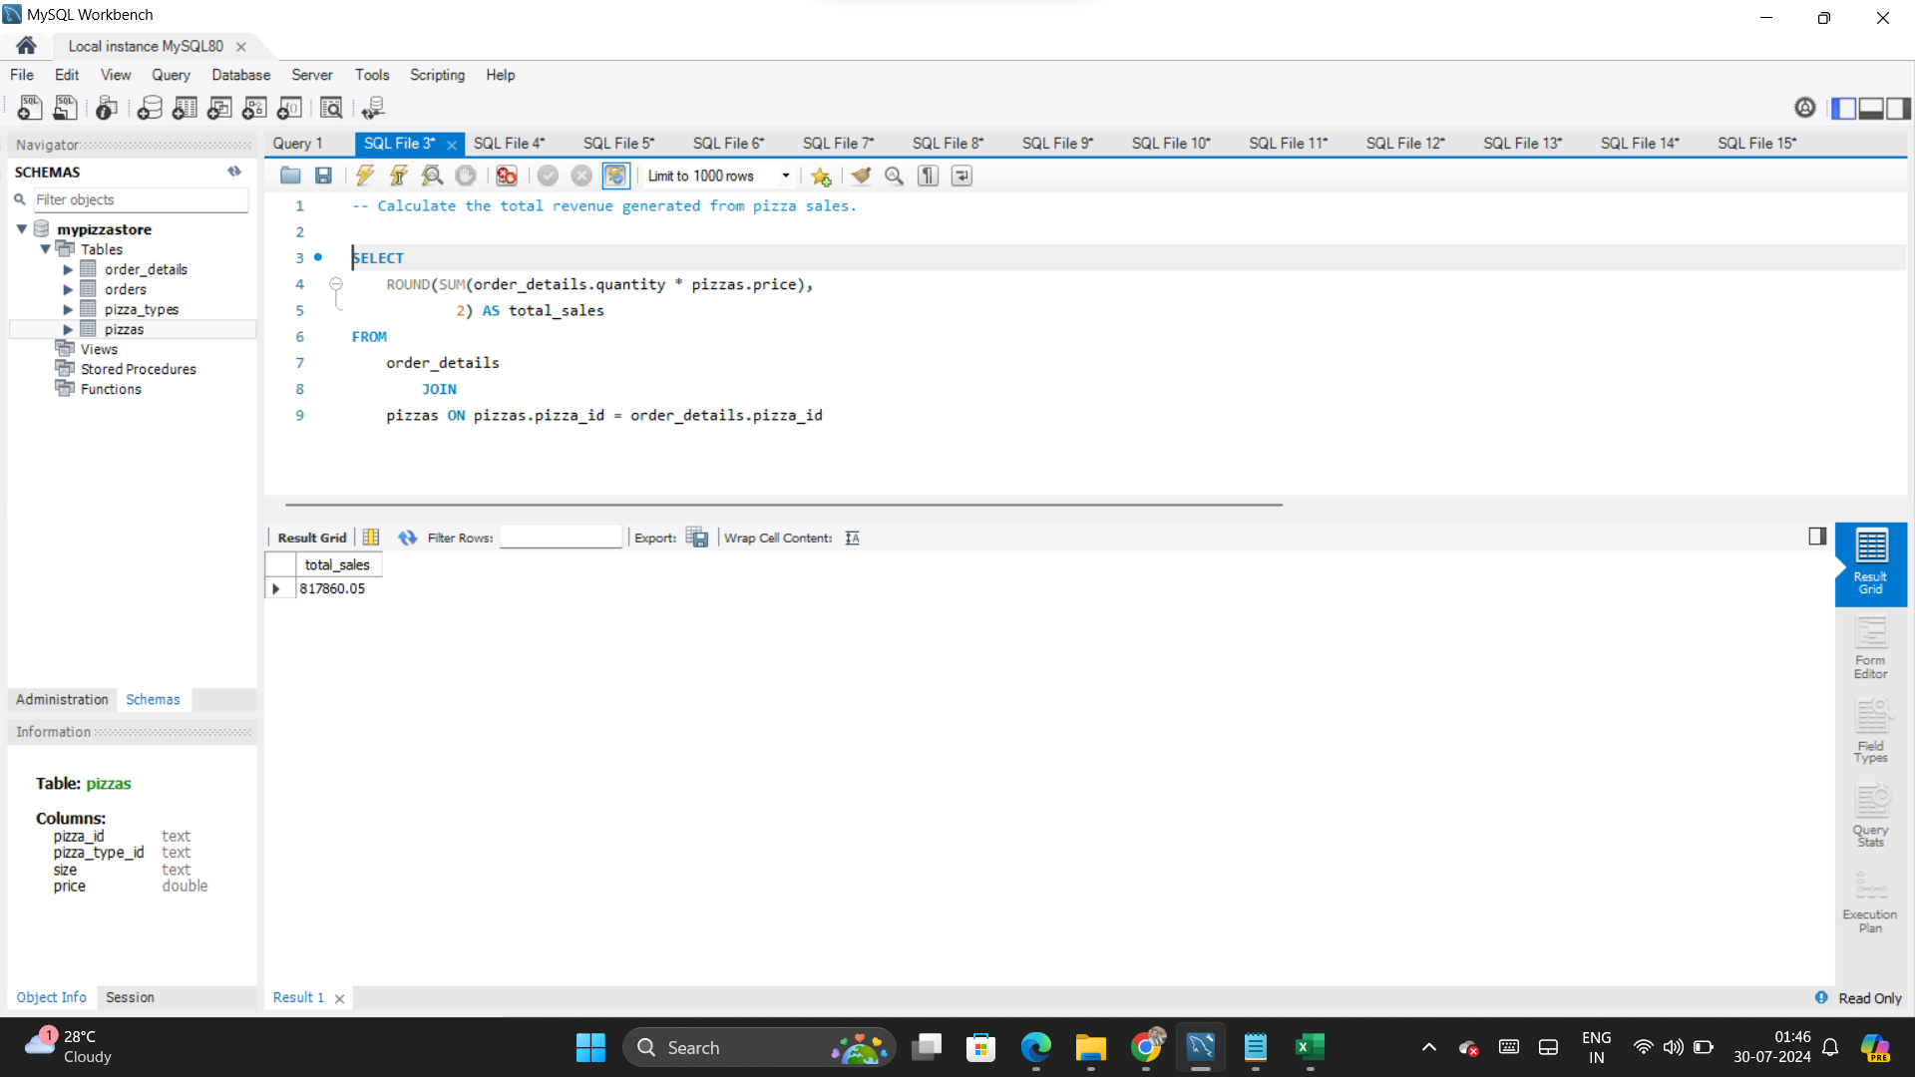
1

Slide 4
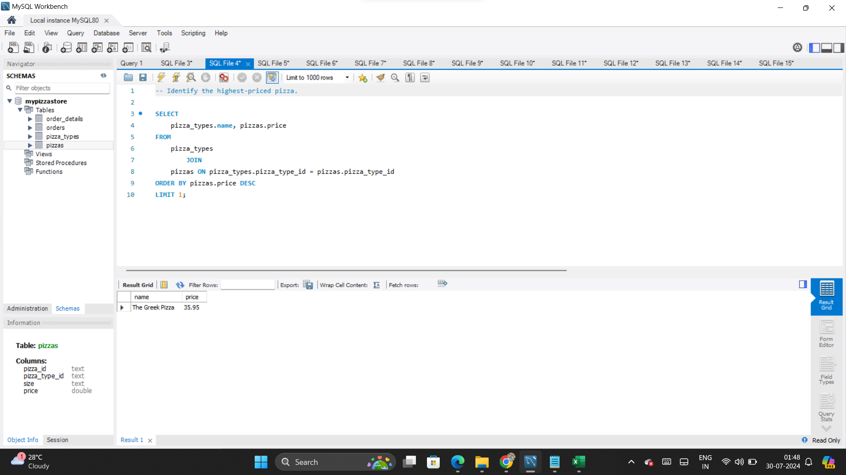
2

Slide 5
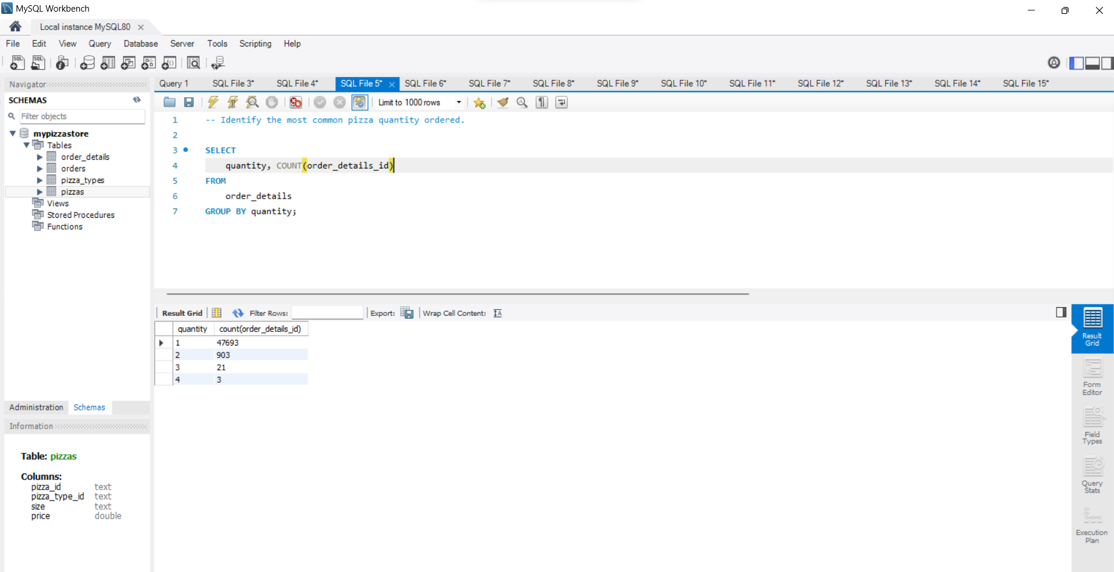
3

Slide 6
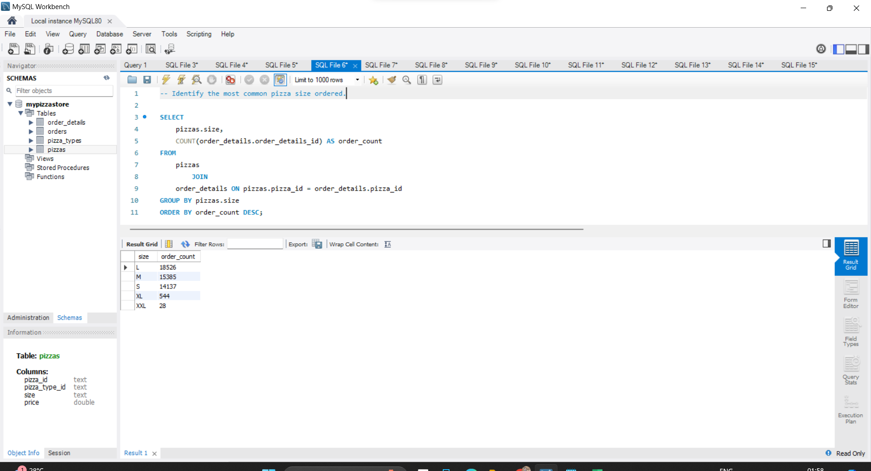
4

Slide 7
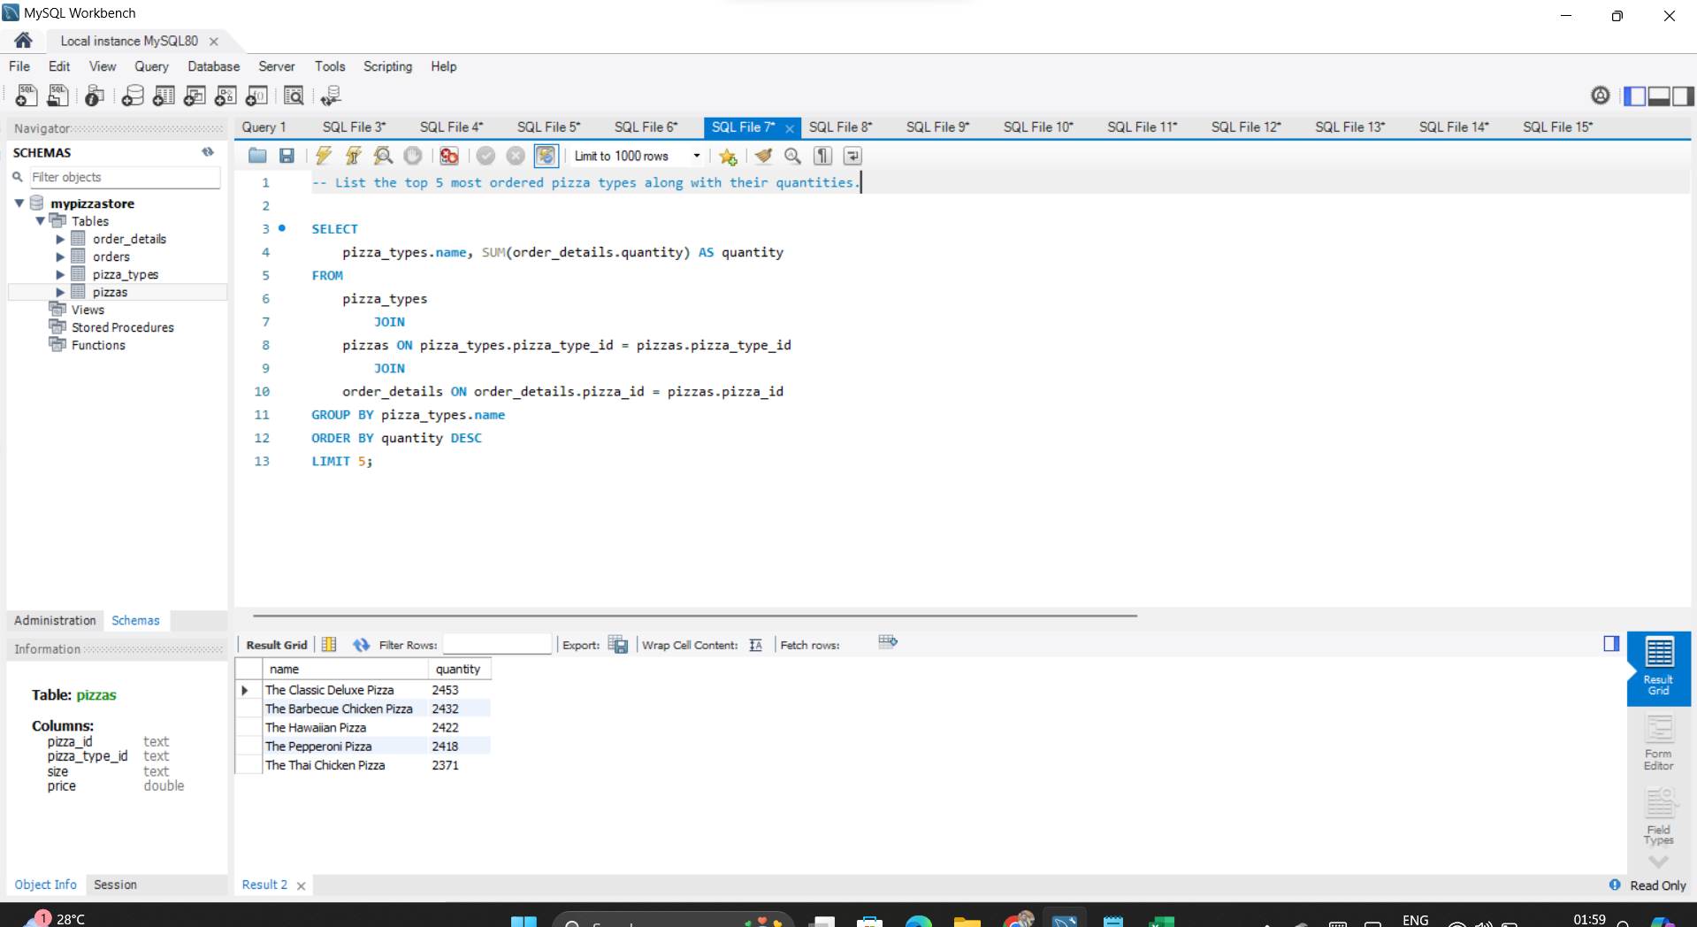
5

Slide 8
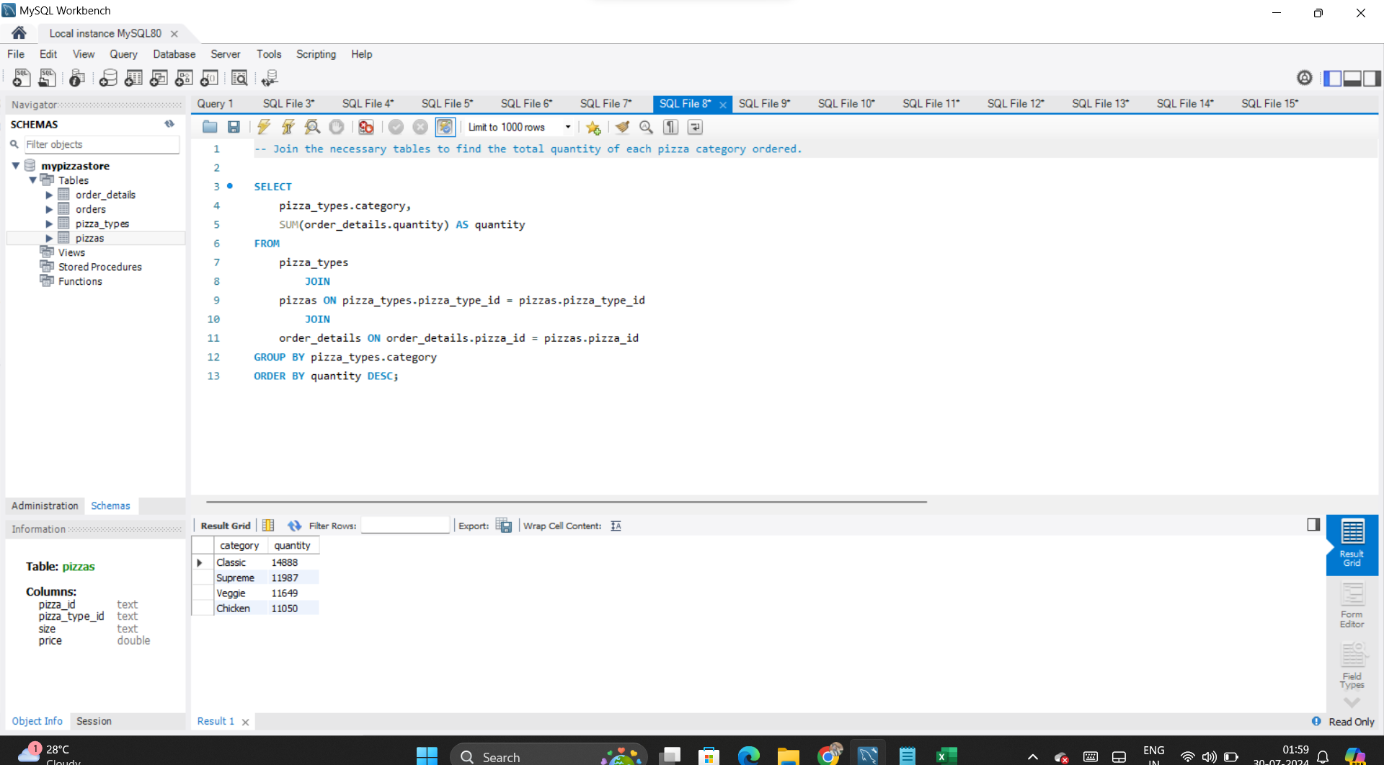
6

Slide 9
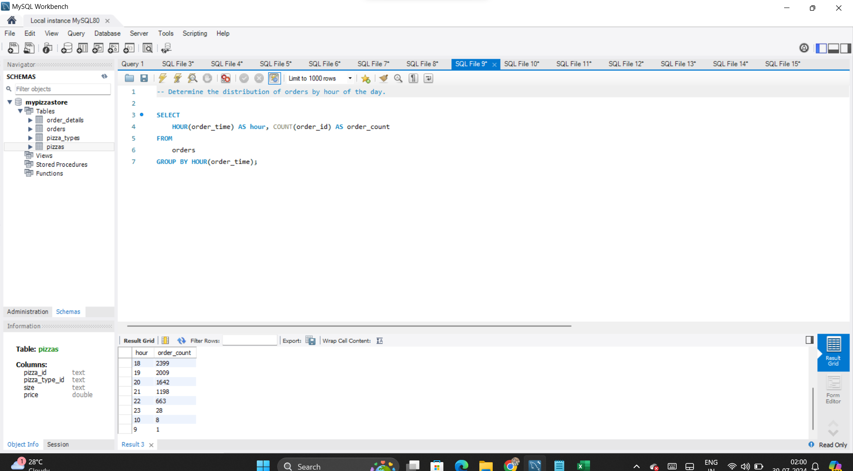
7

Slide 10
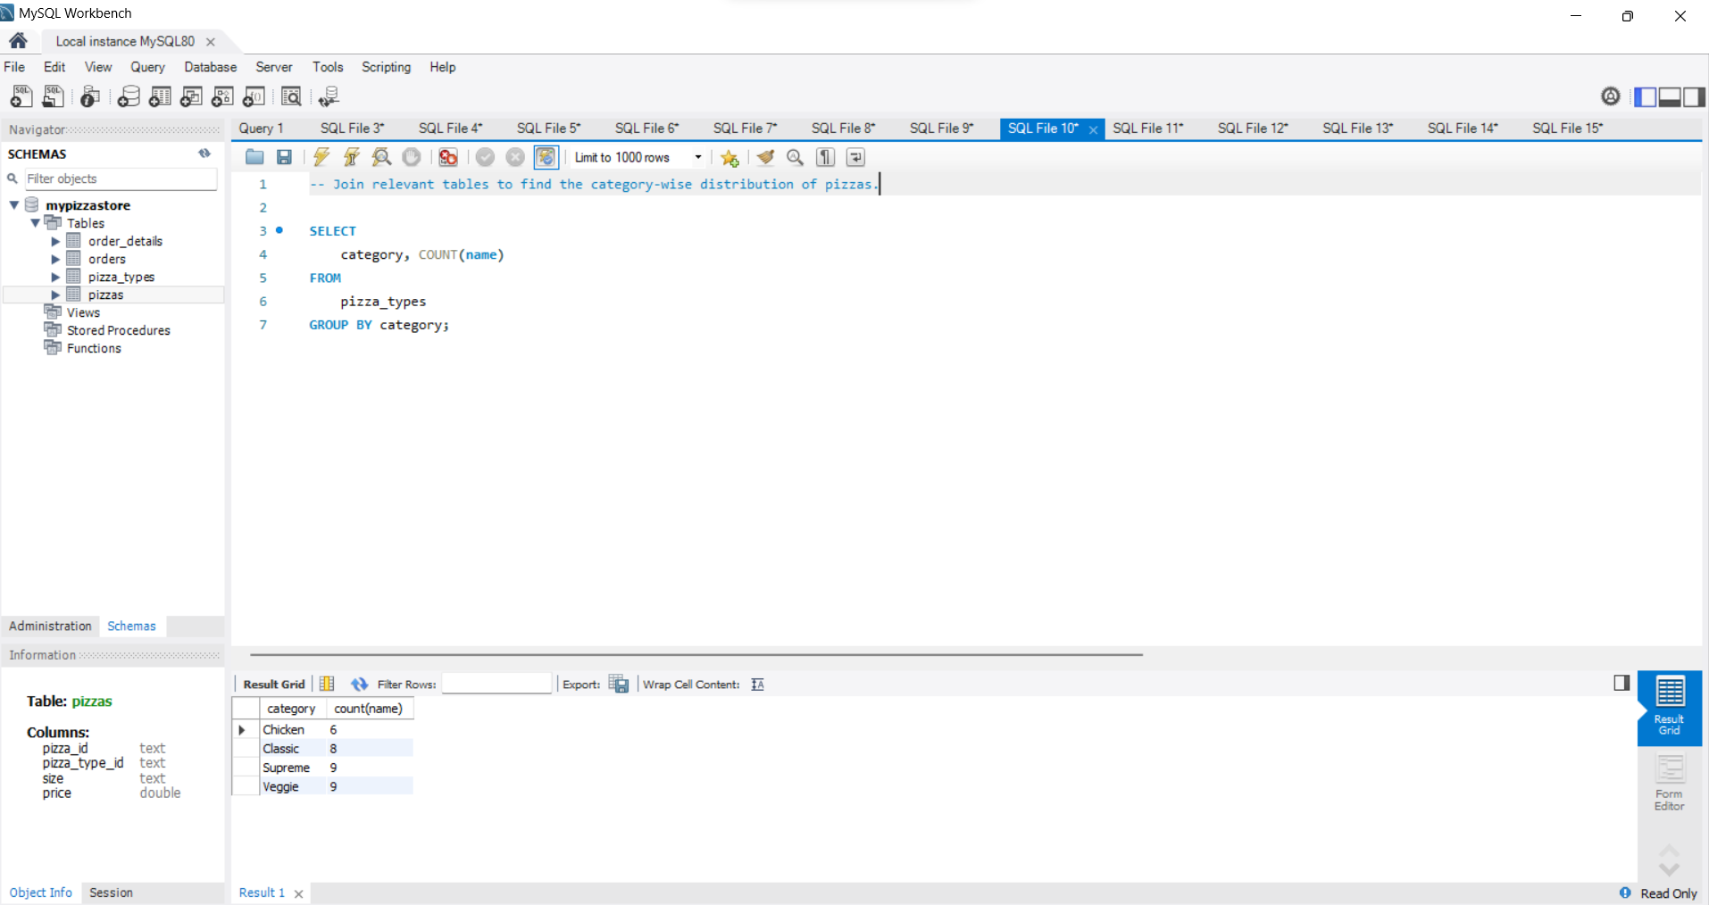
8

Slide 11
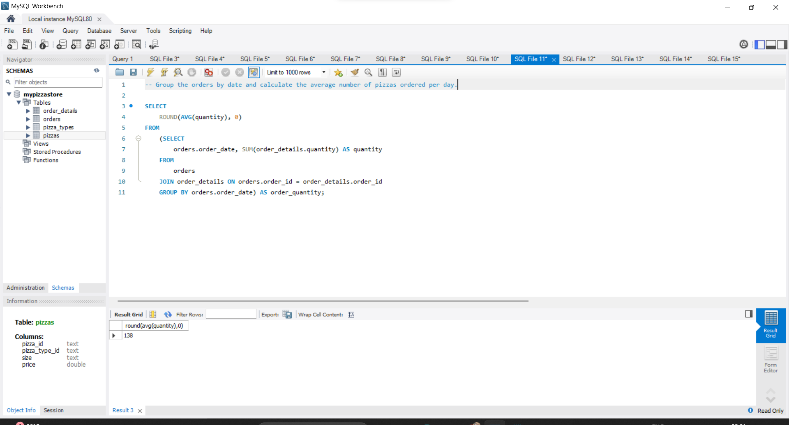
9

Slide 12
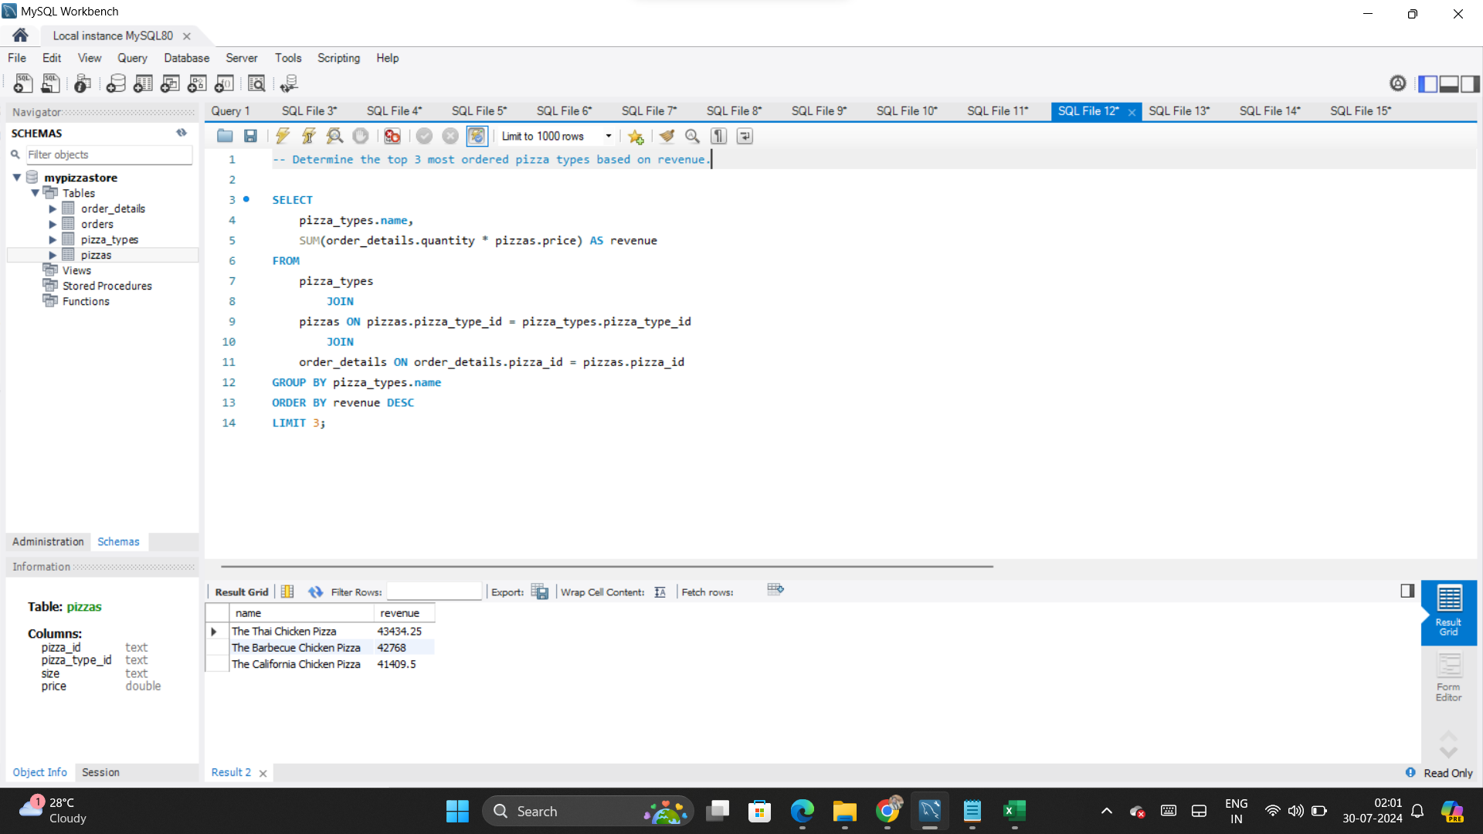
10

Slide 13
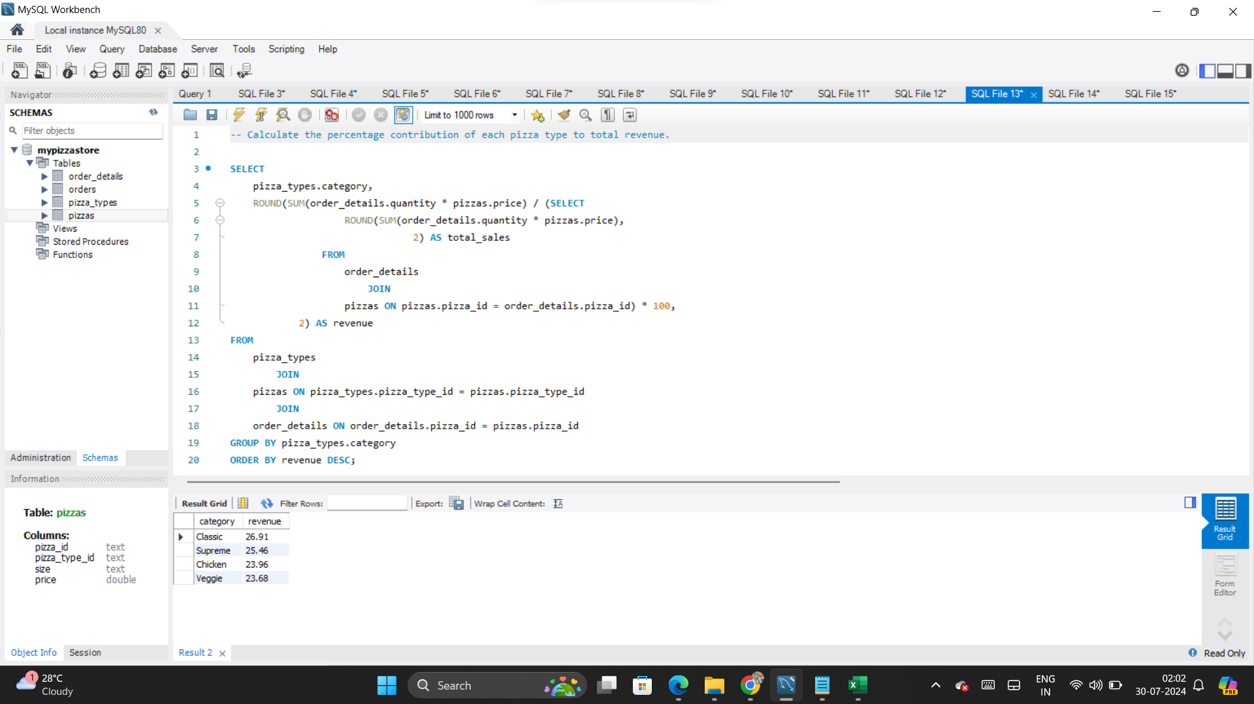
11

Slide 14
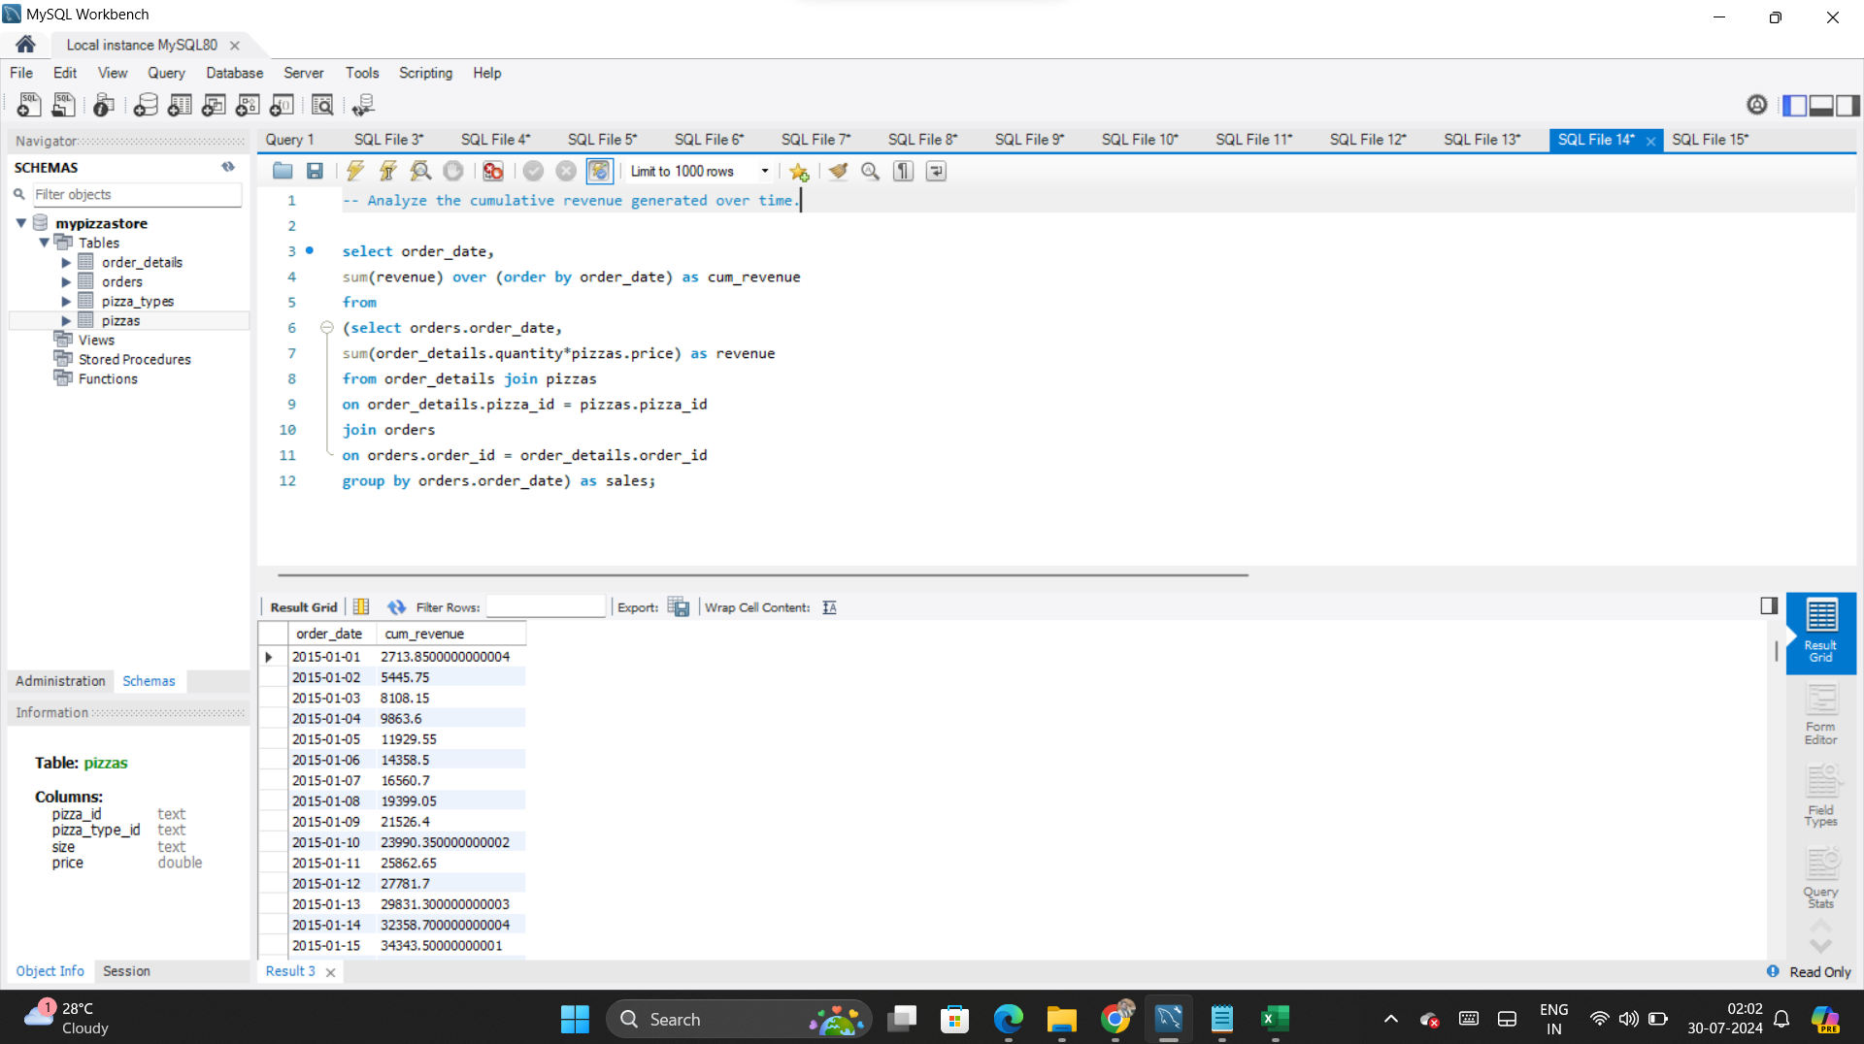
12

Slide 15
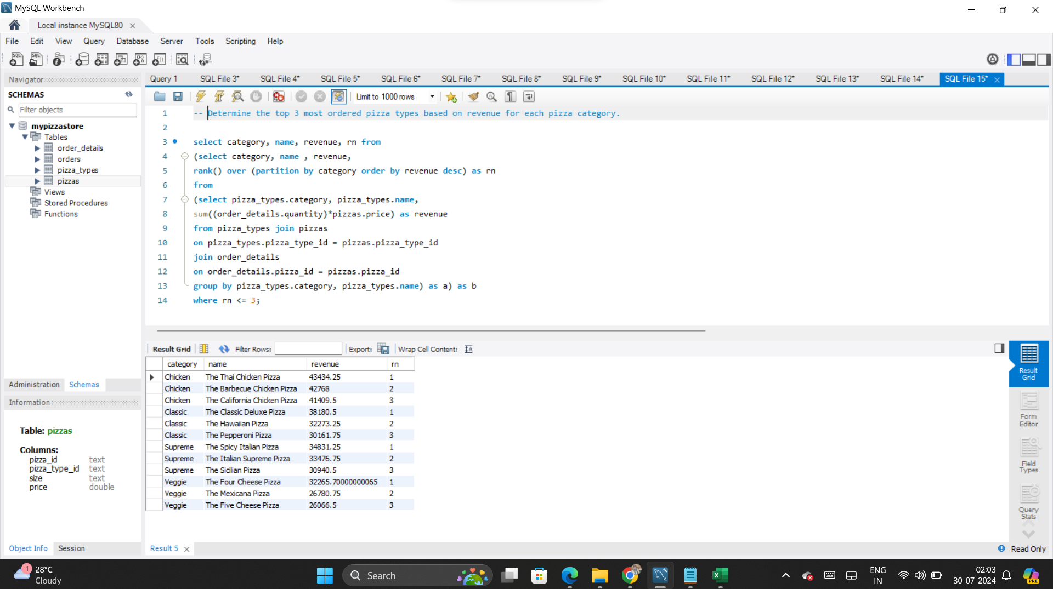
13

Slide 16
Conclusion:
By solving these SQL queries, we gain comprehensive insights into various aspects of pizza sales and orders. We can determine the overall order volume, total revenue, and identify top-performing pizzas in terms of price and popularity. The analysis also reveals patterns in order distribution by time and size preferences. These insights are invaluable for optimizing inventory, tailoring marketing strategies, and enhancing customer satisfaction, ultimately driving business growth and efficiency in pizza operations.
Thank you!

